Slide 1


Slide 2



APLICACIONES WEB ANGULAR 8 (FRONT-END)
Sesión 03
Ing. Erick Arostegui Cunza
Instructor
earostegui@galaxy.edu.pe

Slide 3
AGENDA
CREACIÓN DE SERVICIOS
Creación de módulos.
Creación de servicios.
Implementado el Patrón Factory.
Creación y configuración de rutas y constantes.
Creación de la plantilla del proyecto.

Slide 4
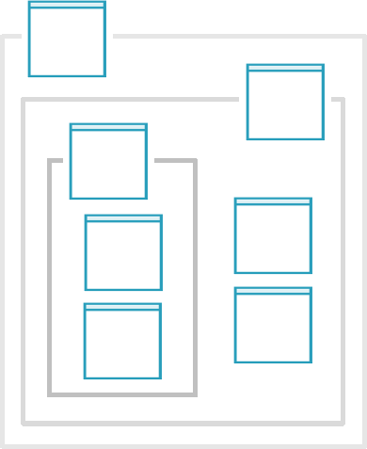
Creación de módulos.
Jerarquía de módulos y componentes
Notes:
1NF: Eliminate Repeating Groups
No duplicate records in the table
• No multi-valued attributes, like storing multiple phone numbers
in a single column
• All entries within a single column must be of the same data type
2NF: Eliminate Redundant Data
• Each column describes the entity that the row represents
• You’ll often achieve this at the same time you’re working on
1NF, because the two are conceptually very similar
• In our 1NF example, the phone number didn’t depend upon the
person – they’re completely separate. So moving the phone
numbers to their own table also achieved 2NF
3NF: Eliminate Non-Dependent Columns
Eliminate transient dependencies
• This is very similar to 2NF. With 2NF, you eliminate cases where
“value1” is not dependent upon the table’s primary key (like the
person’s name)
• With 3NF, you eliminate cases where “value2” is dependent
upon “value1,” but “value1” is still not dependent upon the
table’s primary key
• You can’t really get to 3NF unless you’ve already met 1NF and
2NF – all forms of normalization assume you’ve met all prior
Forms
4NF: No Independent Multiple Relationships
This exists when two columns are brought together to form a
primary key (a composite key), along with a third column
– If the two key columns don’t really uniquely identify the
entity without the presence of the third column, then you’ve
violated the 4NF
5NF: Isolate Semantically Related Relationships
Usually involves relationships with 3+ entities
• Is fairly complex in terms of design, and a detailed description is
beyond the scope of this course

Slide 5
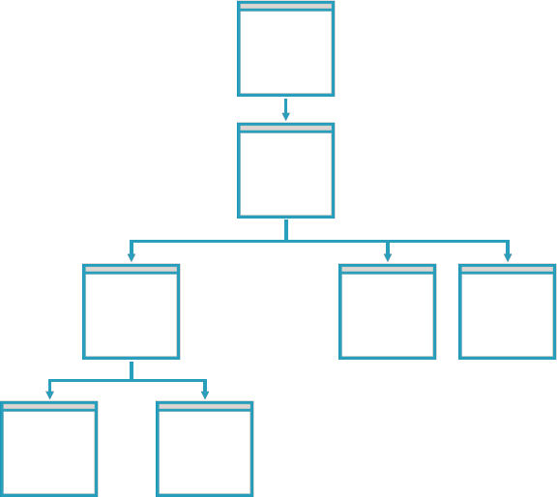
Creación de módulos.
Jerarquía de módulos y componentes
Module
Notes:
1NF: Eliminate Repeating Groups
No duplicate records in the table
• No multi-valued attributes, like storing multiple phone numbers
in a single column
• All entries within a single column must be of the same data type
2NF: Eliminate Redundant Data
• Each column describes the entity that the row represents
• You’ll often achieve this at the same time you’re working on
1NF, because the two are conceptually very similar
• In our 1NF example, the phone number didn’t depend upon the
person – they’re completely separate. So moving the phone
numbers to their own table also achieved 2NF
3NF: Eliminate Non-Dependent Columns
Eliminate transient dependencies
• This is very similar to 2NF. With 2NF, you eliminate cases where
“value1” is not dependent upon the table’s primary key (like the
person’s name)
• With 3NF, you eliminate cases where “value2” is dependent
upon “value1,” but “value1” is still not dependent upon the
table’s primary key
• You can’t really get to 3NF unless you’ve already met 1NF and
2NF – all forms of normalization assume you’ve met all prior
Forms
4NF: No Independent Multiple Relationships
This exists when two columns are brought together to form a
primary key (a composite key), along with a third column
– If the two key columns don’t really uniquely identify the
entity without the presence of the third column, then you’ve
violated the 4NF
5NF: Isolate Semantically Related Relationships
Usually involves relationships with 3+ entities
• Is fairly complex in terms of design, and a detailed description is
beyond the scope of this course

Slide 6
Creación de módulos.
Jerarquía de módulos y componentes
Module
Module
Module
Notes:
1NF: Eliminate Repeating Groups
No duplicate records in the table
• No multi-valued attributes, like storing multiple phone numbers
in a single column
• All entries within a single column must be of the same data type
2NF: Eliminate Redundant Data
• Each column describes the entity that the row represents
• You’ll often achieve this at the same time you’re working on
1NF, because the two are conceptually very similar
• In our 1NF example, the phone number didn’t depend upon the
person – they’re completely separate. So moving the phone
numbers to their own table also achieved 2NF
3NF: Eliminate Non-Dependent Columns
Eliminate transient dependencies
• This is very similar to 2NF. With 2NF, you eliminate cases where
“value1” is not dependent upon the table’s primary key (like the
person’s name)
• With 3NF, you eliminate cases where “value2” is dependent
upon “value1,” but “value1” is still not dependent upon the
table’s primary key
• You can’t really get to 3NF unless you’ve already met 1NF and
2NF – all forms of normalization assume you’ve met all prior
Forms
4NF: No Independent Multiple Relationships
This exists when two columns are brought together to form a
primary key (a composite key), along with a third column
– If the two key columns don’t really uniquely identify the
entity without the presence of the third column, then you’ve
violated the 4NF
5NF: Isolate Semantically Related Relationships
Usually involves relationships with 3+ entities
• Is fairly complex in terms of design, and a detailed description is
beyond the scope of this course

Slide 7
Creación de módulos.
Módulos recomendados
App Module
Core Module
Shared singleton services
App-level components
Shared Module
Share components,
Directives, and pipes
Feature Modules
Feature-level services,
Componentes, directives and pipes
Notes:
1NF: Eliminate Repeating Groups
No duplicate records in the table
• No multi-valued attributes, like storing multiple phone numbers
in a single column
• All entries within a single column must be of the same data type
2NF: Eliminate Redundant Data
• Each column describes the entity that the row represents
• You’ll often achieve this at the same time you’re working on
1NF, because the two are conceptually very similar
• In our 1NF example, the phone number didn’t depend upon the
person – they’re completely separate. So moving the phone
numbers to their own table also achieved 2NF
3NF: Eliminate Non-Dependent Columns
Eliminate transient dependencies
• This is very similar to 2NF. With 2NF, you eliminate cases where
“value1” is not dependent upon the table’s primary key (like the
person’s name)
• With 3NF, you eliminate cases where “value2” is dependent
upon “value1,” but “value1” is still not dependent upon the
table’s primary key
• You can’t really get to 3NF unless you’ve already met 1NF and
2NF – all forms of normalization assume you’ve met all prior
Forms
4NF: No Independent Multiple Relationships
This exists when two columns are brought together to form a
primary key (a composite key), along with a third column
– If the two key columns don’t really uniquely identify the
entity without the presence of the third column, then you’ve
violated the 4NF
5NF: Isolate Semantically Related Relationships
Usually involves relationships with 3+ entities
• Is fairly complex in terms of design, and a detailed description is
beyond the scope of this course

Slide 8
Creación de módulos.
Demo
Creación de módulos.

Slide 9
Creación de servicios.
¿Qué es un servicio Angular?
Notes:
1NF: Eliminate Repeating Groups
No duplicate records in the table
• No multi-valued attributes, like storing multiple phone numbers
in a single column
• All entries within a single column must be of the same data type
2NF: Eliminate Redundant Data
• Each column describes the entity that the row represents
• You’ll often achieve this at the same time you’re working on
1NF, because the two are conceptually very similar
• In our 1NF example, the phone number didn’t depend upon the
person – they’re completely separate. So moving the phone
numbers to their own table also achieved 2NF
3NF: Eliminate Non-Dependent Columns
Eliminate transient dependencies
• This is very similar to 2NF. With 2NF, you eliminate cases where
“value1” is not dependent upon the table’s primary key (like the
person’s name)
• With 3NF, you eliminate cases where “value2” is dependent
upon “value1,” but “value1” is still not dependent upon the
table’s primary key
• You can’t really get to 3NF unless you’ve already met 1NF and
2NF – all forms of normalization assume you’ve met all prior
Forms
4NF: No Independent Multiple Relationships
This exists when two columns are brought together to form a
primary key (a composite key), along with a third column
– If the two key columns don’t really uniquely identify the
entity without the presence of the third column, then you’ve
violated the 4NF
5NF: Isolate Semantically Related Relationships
Usually involves relationships with 3+ entities
• Is fairly complex in terms of design, and a detailed description is
beyond the scope of this course

Slide 10

Creación de servicios.
Servicios
Pieza reutilizable de funcionalidad compartida entre componentes
Responsable de una única pieza discreta de funcionalidad
Capaz de ser entregado cuando y donde se necesita

Slide 11
Creación de servicios.
¿Componentes o Servios?
Notes:
1NF: Eliminate Repeating Groups
No duplicate records in the table
• No multi-valued attributes, like storing multiple phone numbers
in a single column
• All entries within a single column must be of the same data type
2NF: Eliminate Redundant Data
• Each column describes the entity that the row represents
• You’ll often achieve this at the same time you’re working on
1NF, because the two are conceptually very similar
• In our 1NF example, the phone number didn’t depend upon the
person – they’re completely separate. So moving the phone
numbers to their own table also achieved 2NF
3NF: Eliminate Non-Dependent Columns
Eliminate transient dependencies
• This is very similar to 2NF. With 2NF, you eliminate cases where
“value1” is not dependent upon the table’s primary key (like the
person’s name)
• With 3NF, you eliminate cases where “value2” is dependent
upon “value1,” but “value1” is still not dependent upon the
table’s primary key
• You can’t really get to 3NF unless you’ve already met 1NF and
2NF – all forms of normalization assume you’ve met all prior
Forms
4NF: No Independent Multiple Relationships
This exists when two columns are brought together to form a
primary key (a composite key), along with a third column
– If the two key columns don’t really uniquely identify the
entity without the presence of the third column, then you’ve
violated the 4NF
5NF: Isolate Semantically Related Relationships
Usually involves relationships with 3+ entities
• Is fairly complex in terms of design, and a detailed description is
beyond the scope of this course

Slide 12
Creación de servicios.
Servicios
“Limite la lógica en un componente solo a la requerida para la vista. Toda otra lógica debería delegarse a los servicios ".
Angular Style Guide
Style 05-15 (July 2017)
https://angular.io/guide/styleguide#delegate-complex-component-logic-to-services

Slide 13
Creación de servicios.
Servicios
La vista no requiere la funcionalidad necesaria
Debe compartir la lógica o las reglas de negocio entre los componentes.
Necesita compartir datos entre los componentes.
Considere crear un servicio si ... ".

Slide 14
Creación de servicios.
Demo
Creación de servicios.

Slide 15
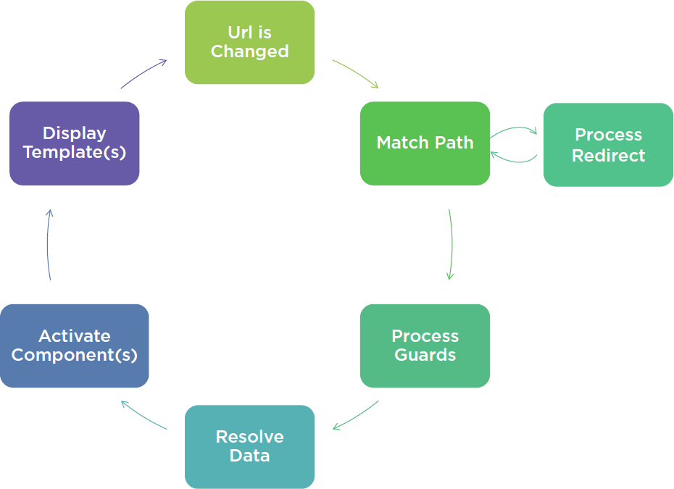
Creación y configuración de rutas y constantes.
Como trabajan la rutas
Notes:
1NF: Eliminate Repeating Groups
No duplicate records in the table
• No multi-valued attributes, like storing multiple phone numbers
in a single column
• All entries within a single column must be of the same data type
2NF: Eliminate Redundant Data
• Each column describes the entity that the row represents
• You’ll often achieve this at the same time you’re working on
1NF, because the two are conceptually very similar
• In our 1NF example, the phone number didn’t depend upon the
person – they’re completely separate. So moving the phone
numbers to their own table also achieved 2NF
3NF: Eliminate Non-Dependent Columns
Eliminate transient dependencies
• This is very similar to 2NF. With 2NF, you eliminate cases where
“value1” is not dependent upon the table’s primary key (like the
person’s name)
• With 3NF, you eliminate cases where “value2” is dependent
upon “value1,” but “value1” is still not dependent upon the
table’s primary key
• You can’t really get to 3NF unless you’ve already met 1NF and
2NF – all forms of normalization assume you’ve met all prior
Forms
4NF: No Independent Multiple Relationships
This exists when two columns are brought together to form a
primary key (a composite key), along with a third column
– If the two key columns don’t really uniquely identify the
entity without the presence of the third column, then you’ve
violated the 4NF
5NF: Isolate Semantically Related Relationships
Usually involves relationships with 3+ entities
• Is fairly complex in terms of design, and a detailed description is
beyond the scope of this course

Slide 16
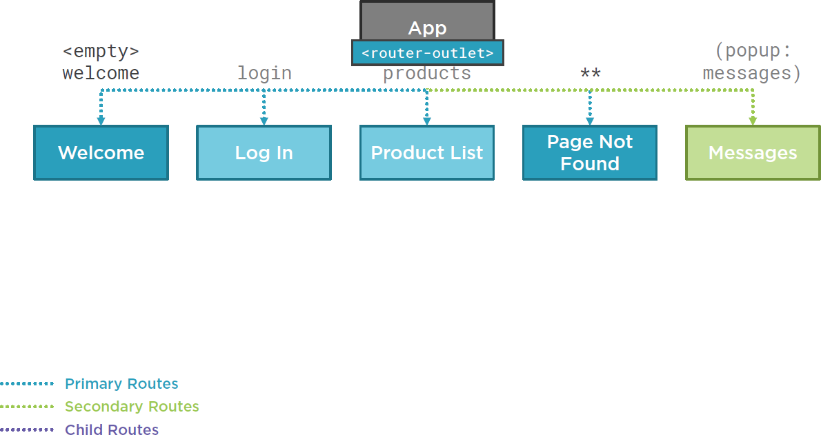
Creación y configuración de rutas y constantes.
Como trabajan la rutas
Notes:
1NF: Eliminate Repeating Groups
No duplicate records in the table
• No multi-valued attributes, like storing multiple phone numbers
in a single column
• All entries within a single column must be of the same data type
2NF: Eliminate Redundant Data
• Each column describes the entity that the row represents
• You’ll often achieve this at the same time you’re working on
1NF, because the two are conceptually very similar
• In our 1NF example, the phone number didn’t depend upon the
person – they’re completely separate. So moving the phone
numbers to their own table also achieved 2NF
3NF: Eliminate Non-Dependent Columns
Eliminate transient dependencies
• This is very similar to 2NF. With 2NF, you eliminate cases where
“value1” is not dependent upon the table’s primary key (like the
person’s name)
• With 3NF, you eliminate cases where “value2” is dependent
upon “value1,” but “value1” is still not dependent upon the
table’s primary key
• You can’t really get to 3NF unless you’ve already met 1NF and
2NF – all forms of normalization assume you’ve met all prior
Forms
4NF: No Independent Multiple Relationships
This exists when two columns are brought together to form a
primary key (a composite key), along with a third column
– If the two key columns don’t really uniquely identify the
entity without the presence of the third column, then you’ve
violated the 4NF
5NF: Isolate Semantically Related Relationships
Usually involves relationships with 3+ entities
• Is fairly complex in terms of design, and a detailed description is
beyond the scope of this course

Slide 17

Creación y configuración de rutas y constantes.
Navegando por las Rutas de la Aplicación
Opción de menú, enlace, imagen o botón que activa una ruta
Escribir la URL en la barra de direcciones / marcador
Los botones de avance o retroceso del navegador

Slide 18

Creación y configuración de rutas y constantes.
¿Por qué definir un módulo de enrutamiento?
Mejor organización
Más fácil de encontrar.
Separación de responsabilidades

Slide 19
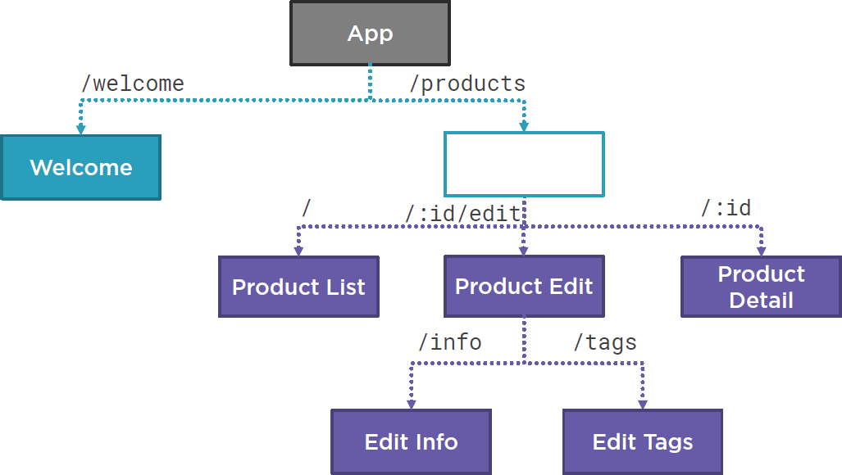
Creación y configuración de rutas y constantes.
Rutas hijas
Notes:
1NF: Eliminate Repeating Groups
No duplicate records in the table
• No multi-valued attributes, like storing multiple phone numbers
in a single column
• All entries within a single column must be of the same data type
2NF: Eliminate Redundant Data
• Each column describes the entity that the row represents
• You’ll often achieve this at the same time you’re working on
1NF, because the two are conceptually very similar
• In our 1NF example, the phone number didn’t depend upon the
person – they’re completely separate. So moving the phone
numbers to their own table also achieved 2NF
3NF: Eliminate Non-Dependent Columns
Eliminate transient dependencies
• This is very similar to 2NF. With 2NF, you eliminate cases where
“value1” is not dependent upon the table’s primary key (like the
person’s name)
• With 3NF, you eliminate cases where “value2” is dependent
upon “value1,” but “value1” is still not dependent upon the
table’s primary key
• You can’t really get to 3NF unless you’ve already met 1NF and
2NF – all forms of normalization assume you’ve met all prior
Forms
4NF: No Independent Multiple Relationships
This exists when two columns are brought together to form a
primary key (a composite key), along with a third column
– If the two key columns don’t really uniquely identify the
entity without the presence of the third column, then you’ve
violated the 4NF
5NF: Isolate Semantically Related Relationships
Usually involves relationships with 3+ entities
• Is fairly complex in terms of design, and a detailed description is
beyond the scope of this course

Slide 20
Creación y configuración de rutas y constantes.
Demo
Creación y configuración de rutas y constantes.

Slide 21
Creación de la plantilla del proyecto
Demo
Creación de la plantilla del proyecto

Slide 22


